Slide 1
TEAM 3
TEAM MEMBERS
KL SAIKRISHNA 94036_IN
MENEGA 93959_IN
HRISHIKESH S 93956_IN
SUJANA 94001_IN
BHAVANA 93938_IN R VINAYKUMAR 93992_IN

Slide 2
AGENDA
Hardware
Windows Fundamentals
Linux Fundamentals
Network Fundamentals
Network Services
Database
Applications
Storage

Slide 3
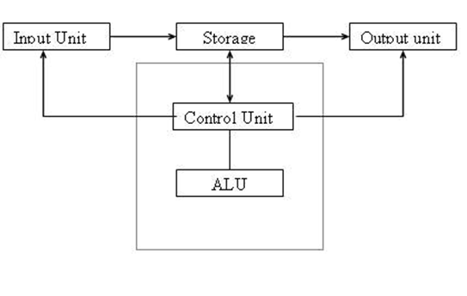
HARDWARE
What is Computer?
It has-
Input unit
Output unit
Storage
Control unit
ALU

Slide 4

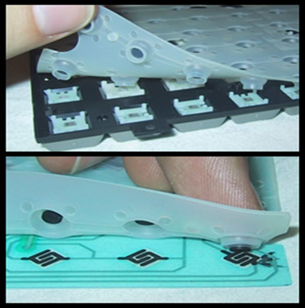
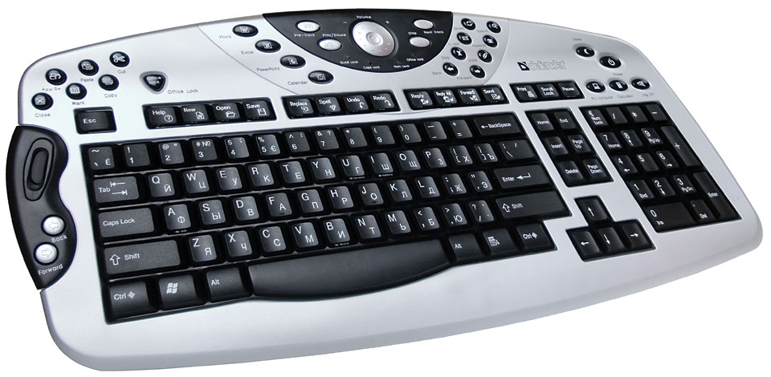
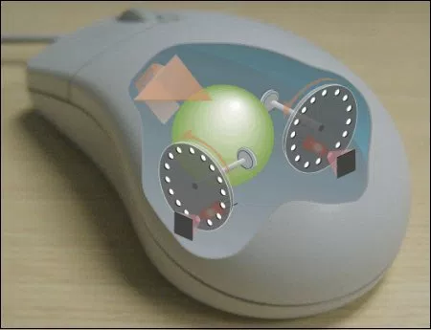
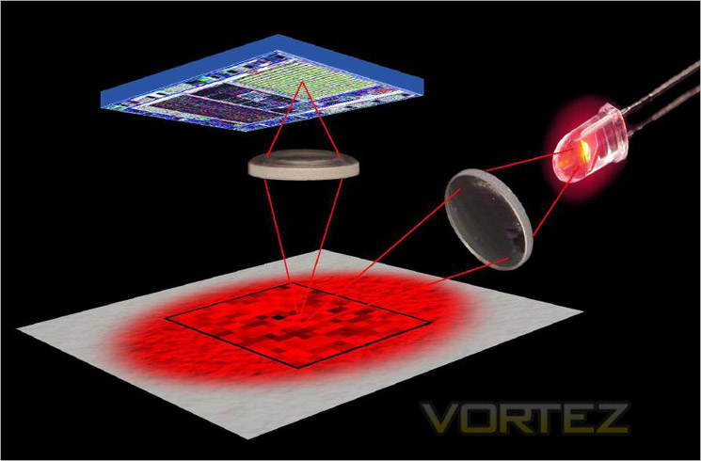

INPUT DEVICES
Keyboard
Types of keyboard
Mechanical
Membrane
multimedia
Mouse
Types of mouse
Mechanical
Optical
Wireless

Slide 5
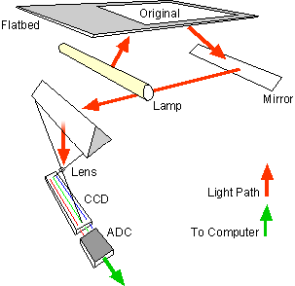
Working principle of scanner
(Charge Coupled Device)
(Analog to Digital converter)

Slide 6
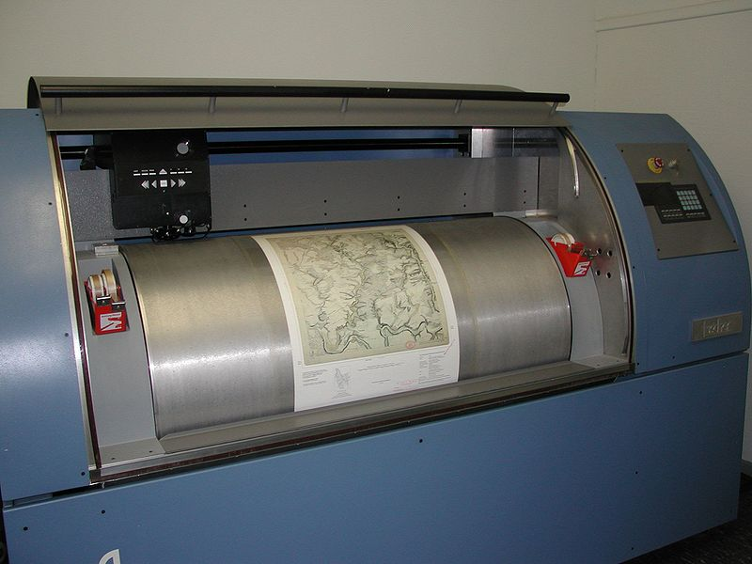
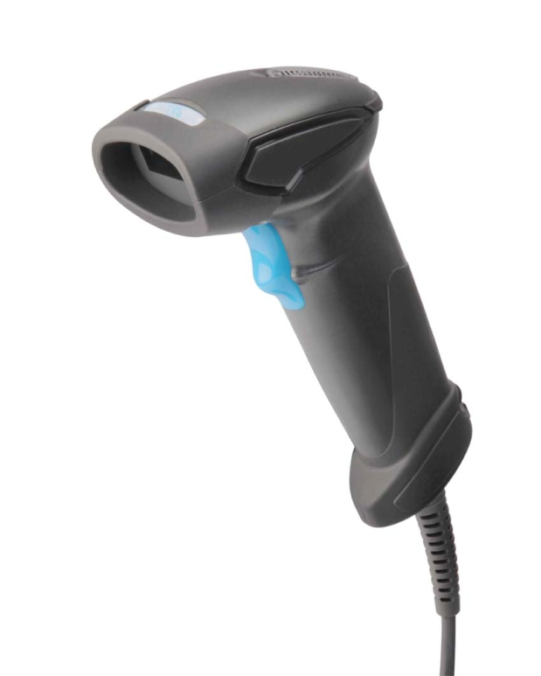
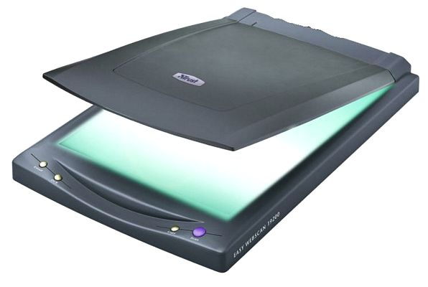
SCANNER
Scanner
Types of scanner
Flatbed scanner
Drum scanner
Handheld scanner

Slide 7
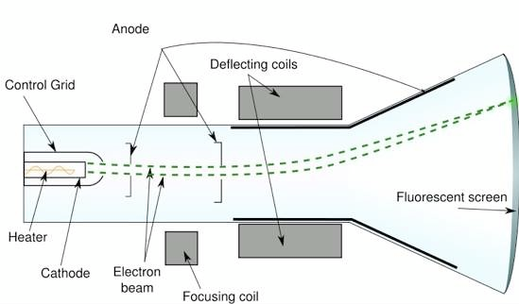
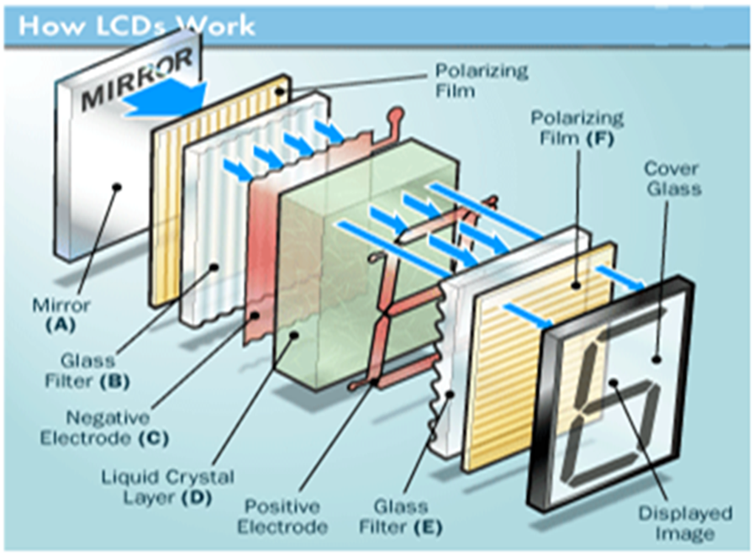
OUTPUT DEVICES
Monitor
CRT Monitor
LED
LCD

Slide 8
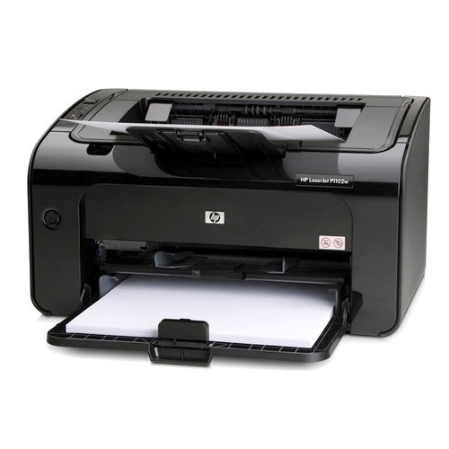
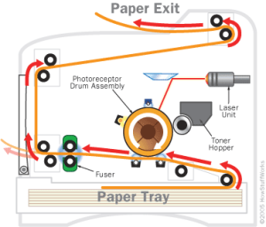
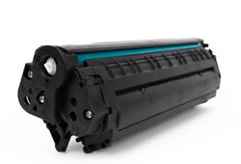
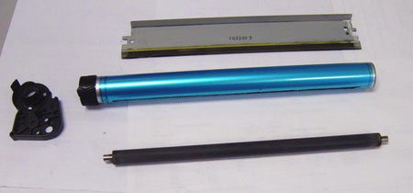
PRINTERS
Types of printers
1.Laser jet
2.Ink jet
3.Dot-Matrix
Components of laser jet
Tonner hopper
Laser unit
Drum assembly
Fuser
Paper tray
Laser Jet Printer

Slide 9
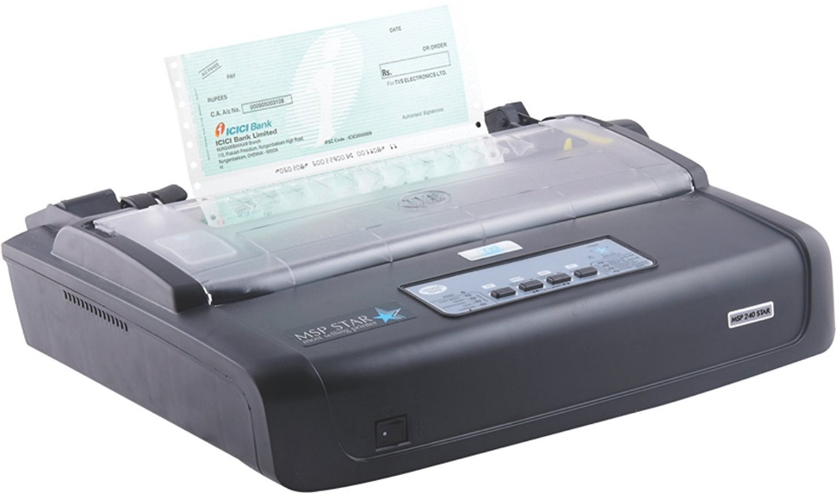
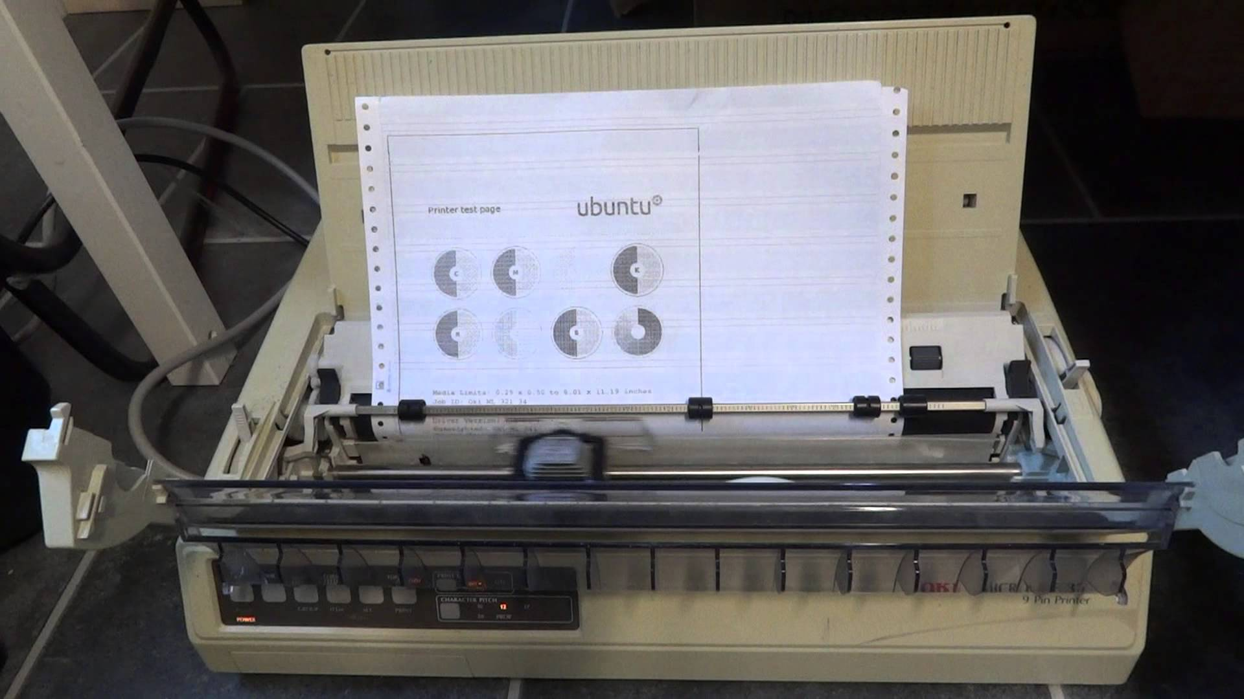
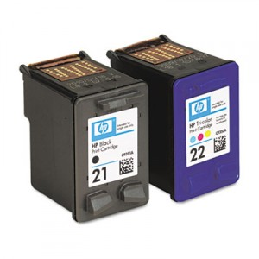
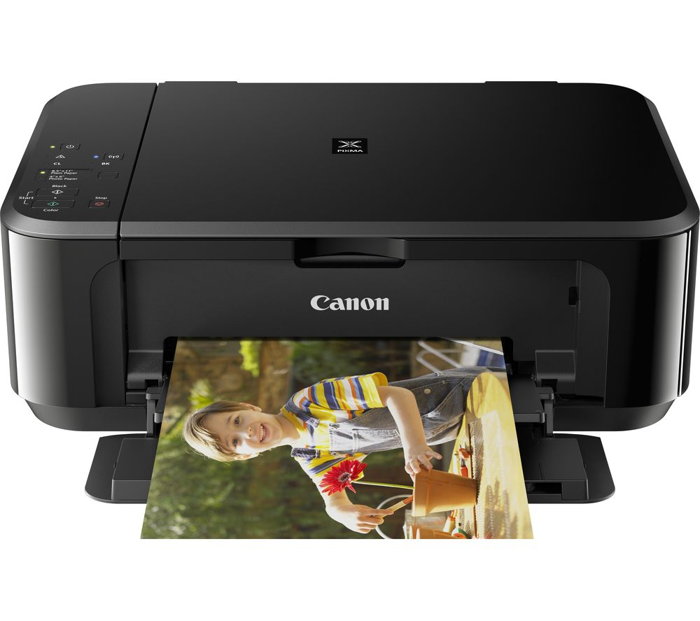

DOT MATRIX PRINTER
INK JET PRINTER

Slide 10
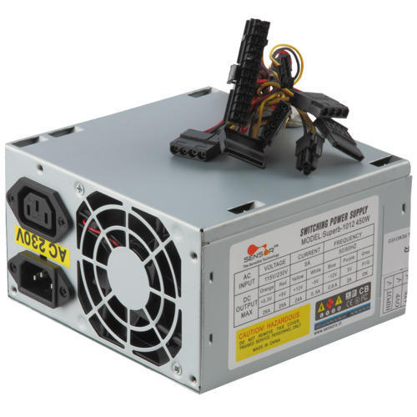
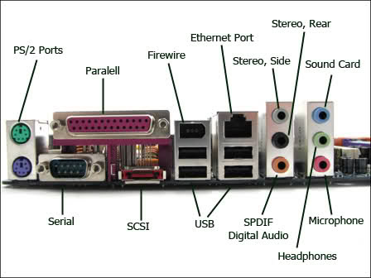
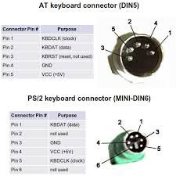
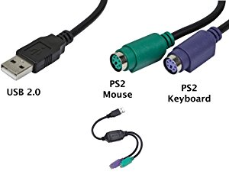
SMPS
Ports To Be Connected
Connectors

Slide 11
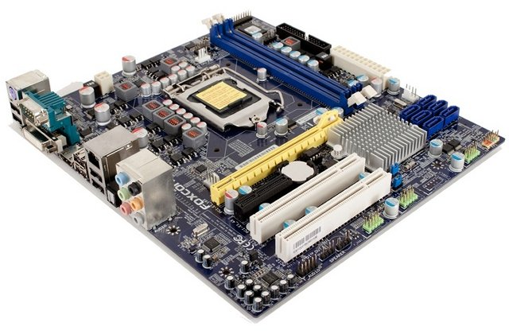
Motherboard
DIMM SLOT
CPU SOCKET
SATA CONNECTORS
SOUTH BRIDGE
CMOS BATTERY
BACK PANEL
(PERIPHERAL CONNECTORS)
PCI SLOT
FRONT PANEL CONNECTOR PINS
PCI XPRESS SLOT

Slide 12
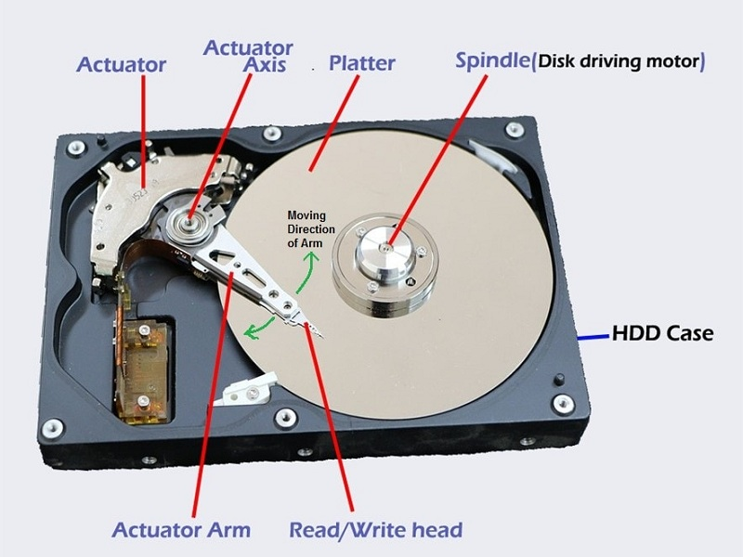
HARD DISK

Slide 13
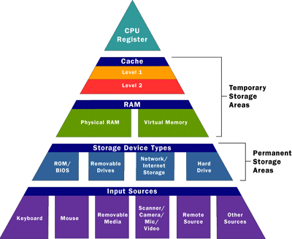
Memory

Slide 14
WINDOWS FUNDEMANTALS

Slide 15
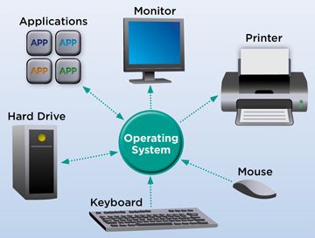
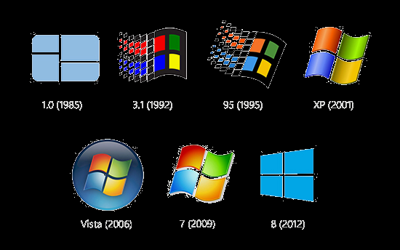
Operating system
Simple Batch System
Multiprogramming Batch System
Multiprocessor System
Desktop System
Distributed Operating System
Clustered System
Real time Operating System

Slide 16
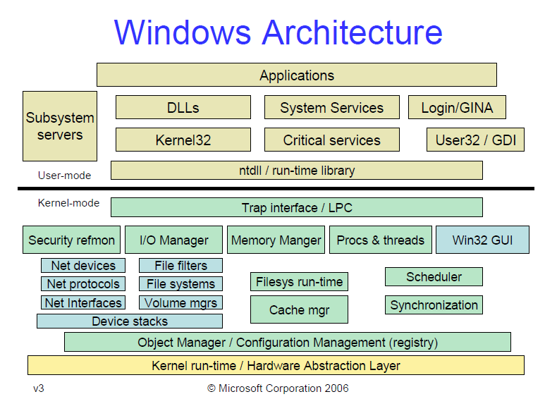
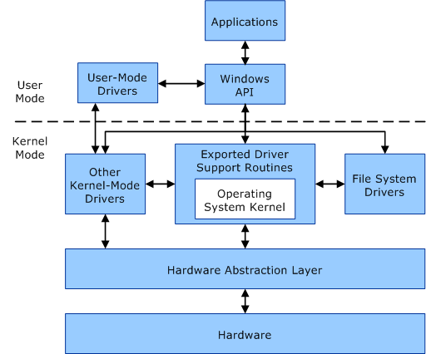
KERNEL ARCHITECTURE

Slide 17
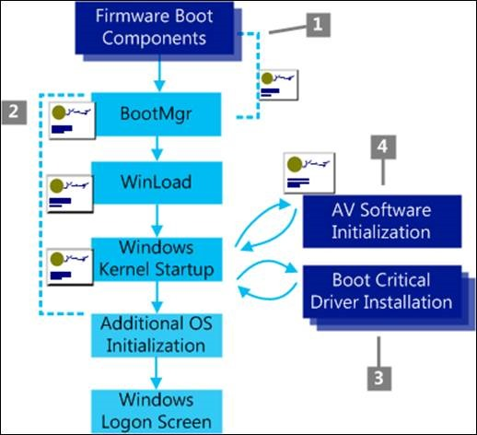
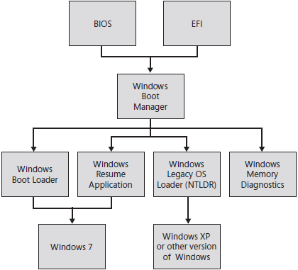
Windows Booting Process

Slide 18
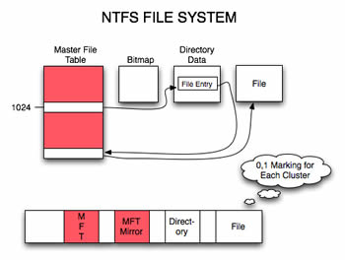
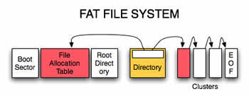
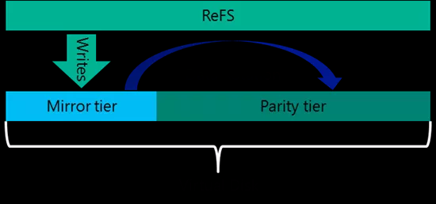
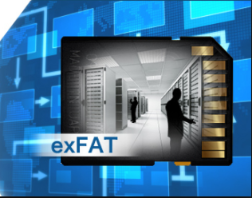
File System

Slide 19
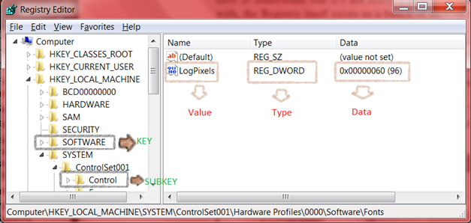
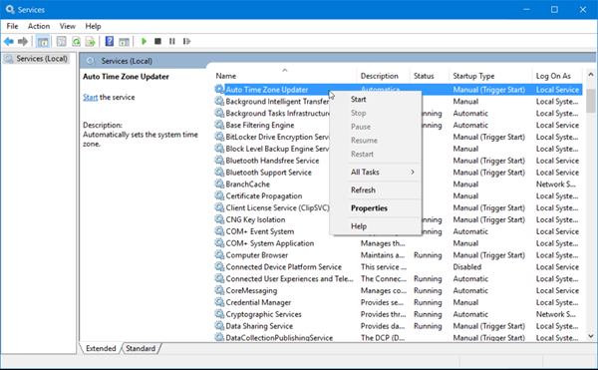
Management Mechanisms
Registry
Services
The Windows Registry is a collection of databases of configuration settings in Microsoft Windows operating systems
The Service Control Manager (SCM) is the key component of the operating system responsible for providing a management interface to services.

Slide 20
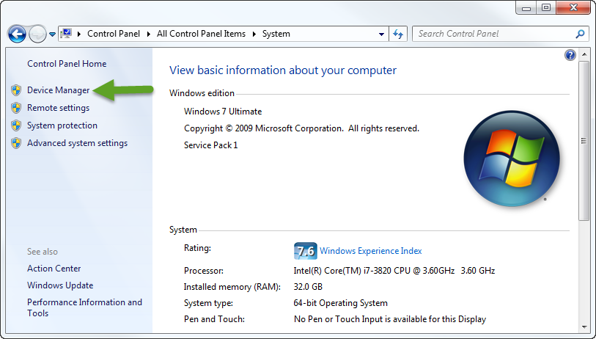
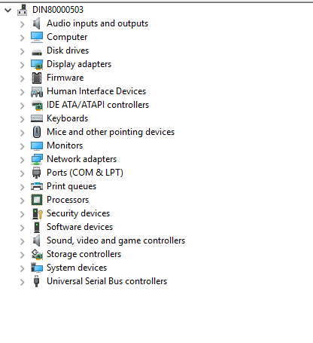
Device Management
Device Driver
Power Manager States
Suspended
Resuming
Screen Off
On
Backlight Off
User Idle

Slide 21
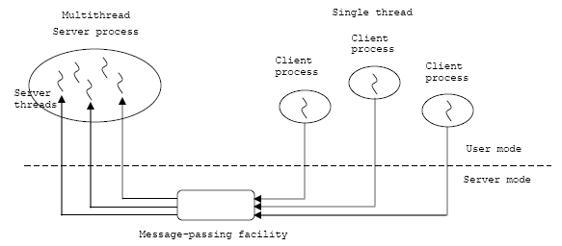
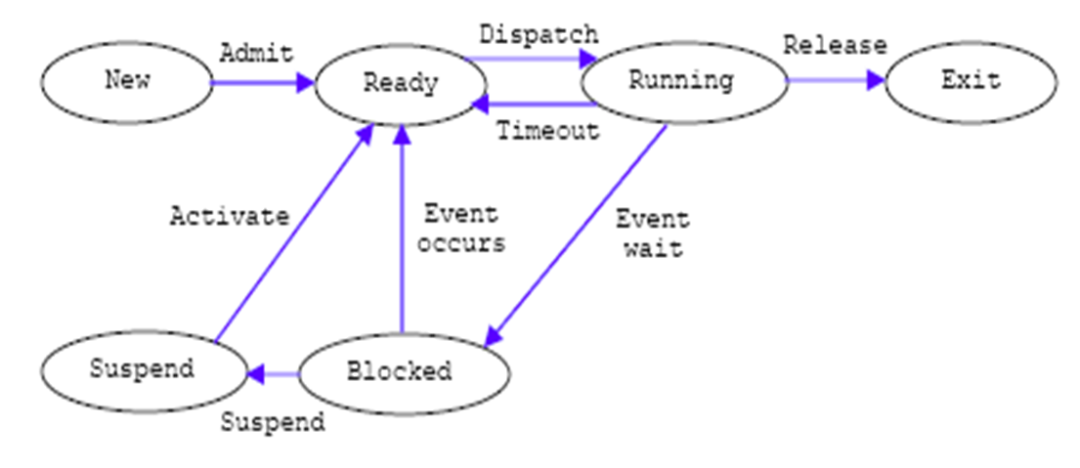
Process Management
Process
A collection of one or more threads and associated system resources such as memory, open files and devices.
Threads
The smallest sequence of programmed instructions
Process States

Slide 22
Memory Management
Virtual Memory - A virtual memory management systems maps the virtual addresses of the pages with
the physical addresses of the pages after the pages of the program has been loaded at RAM.
Virtual Address Space - The address space for each process is private and cannot be accessed by other
processes unless it is shared. A virtual address does not represent the actual physical location of an object in memory.
Paging – It is a memory management scheme that eliminates the need for contiguous allocation of physical memory.
Memory Pool - It also called fixed-size blocks allocation, is the use of pools for memory management that allows dynamic memory allocation.
Paged pool
Non paged pool

Slide 23
Linux Fundamentals

Slide 24


Introduction:
Linux was introduces by Linus Torvalds in the year 1991.
Software Version
Alpha
Beta

Slide 25

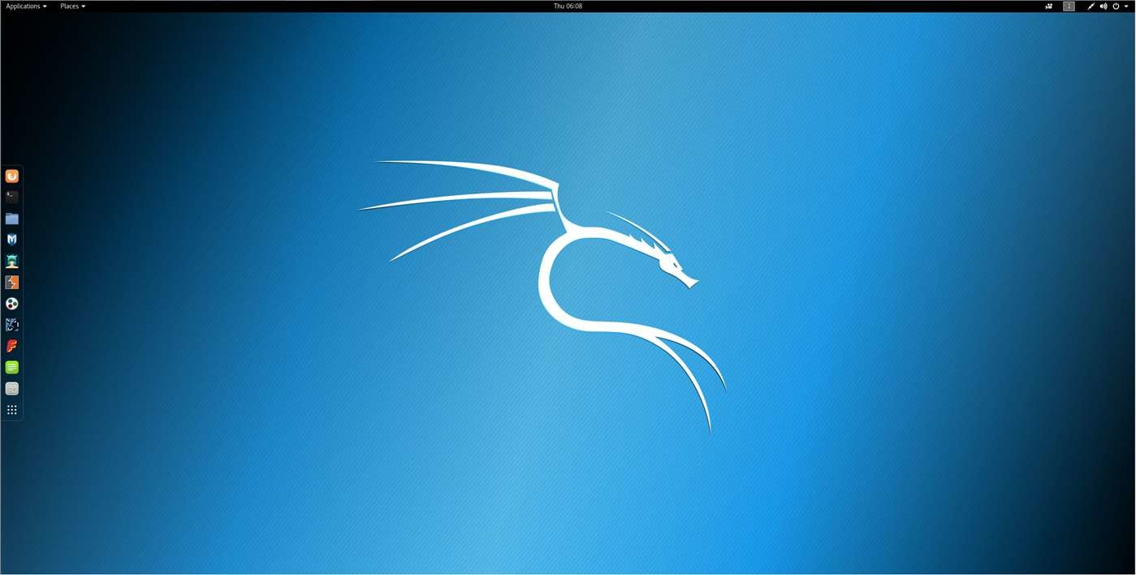



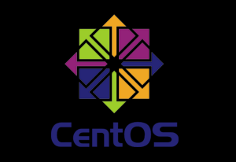
Linux Subsystem:
Linux
OS Services
USER Application
Linux Kernel
Hardware Controller

Slide 26
Linux Kernel
Memory Management
Virtual Files System
Process Scheduler
Inter-process Communication
Run Levels
0- Halt.
1-Single User Mode.
2-MultiUser mode with Network.
3-Full multiuser Mode.
4-Unused.
5-X11.
6-Reboot.
Network Interface

Slide 27
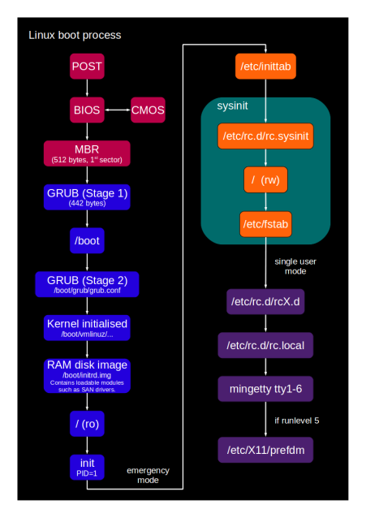
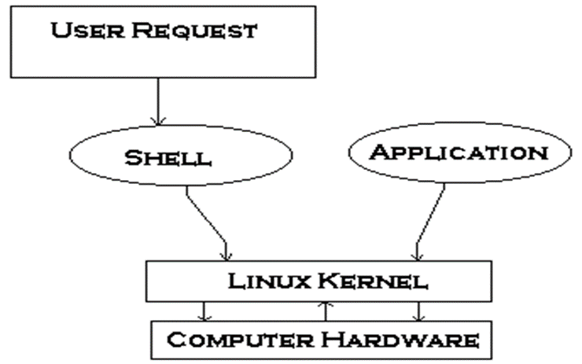
Booting Process
Shell
Types Of Shell
Ash.
Bourne.
BASH.
Corn.
T-Shell.
C-Shell.
Z-Shell.

Slide 28
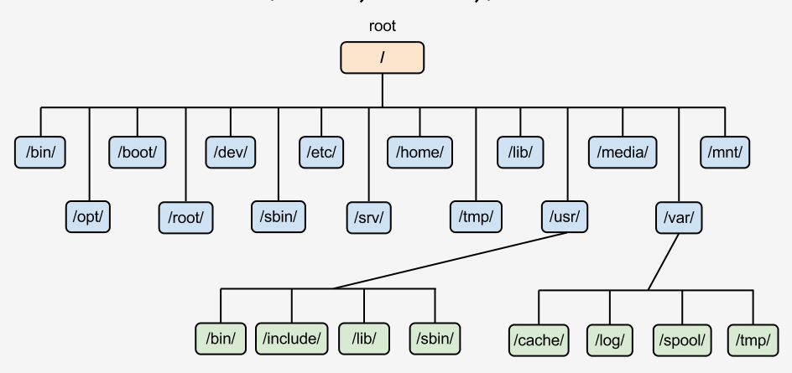
File Management
Types of Linux File System.
1.Ext 2.
2.Ext 3.
3.Ext 4.
Journaling.
1.Write back.
2.Ordered.
3.Data.

Slide 29
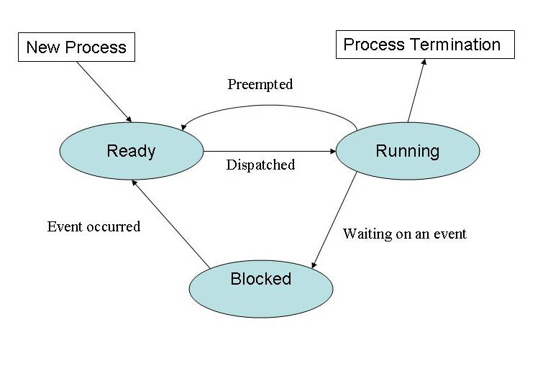
Types of process
Init process.
Parent process.
Child process.
Daemon process.
Orphan process.
Zombie process.
Interactive process.
Automatic process.
Real time process.
Types of Process Scheduling
FCFS (First Come First Serve).
SJF (Shortest Job First).
Round Robin.
Priority Scheduling.

Slide 30
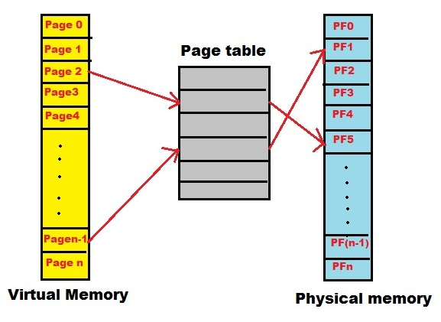
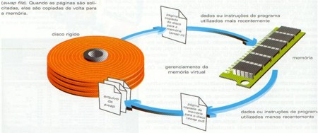
Device Management
Block Device
Character Device
Device Management .
Device files (/dev).
IRQ.
Memory Management
Memory Management
Buddy System
LRU

Slide 31
NETWORK FUNDEMANTALS

Slide 32






Network Devices
HUB
Switch
Router
Repeater
NIC
Bridge

Slide 33







TYPES OF NETWORKS

Slide 34


Network Topologies

Slide 35

TCP/IP LAYERS AND OSI LAYERS

Slide 36

IP ADDRESS CLASSES

Slide 37
NETWORK SERVICES

Slide 38

DHCP
Used to dynamically assign an IP address to any node
ADVANTAGES
TECHNOLOGIES PRIOR TO DHCP
STEP BY STEP PROCESS

Slide 39

DNS
The Domain Name System (DNS) is a hierarchical decentralized naming system for computers, services, or other resources connected to the Internet or a private network.

Slide 40

DIRECTORY SERVICES
Directory services contain data and metadata
X.500 formed the basis of a standard that is widely deployed known as LDAP

Slide 41

MAIL SERVICES
An application that receives incoming e-mail from local users and remote senders and forwards outgoing e-mail for delivery.
MTA
MUA
LDP
SMTP
POP3
IMAP4
MAPI

Slide 42

PROXY SERVICES
Acts as an intermediary between the user's computer and the Internet
Proxy caching is a feature of proxy servers that stores content on the proxy server itself, allowing web services to share those resources to more users.

Slide 43

WEB SERVICES
It’s a service offered by an electronic device to another electronic device, communicating with each other via the World Wide Web.

Slide 44
APPLICATIONS

Slide 45
APPLICATIONS
An application program is a computer program designed to perform a group of coordinated functions, tasks, or activities for the benefit of the user.
PRESENTATION LAYER
BUSINESS LOGIC LAYER
DATA ACCESS LAYER
COMPONENTS
COMPILER
INTERPRETER
TYPES:

Slide 46

APPLICATIONS - LIFE CYCLE

Slide 47

API
An application program interface (API) is code that allows two software programs to communicate with each other.
TYPES OF ATTACKS:
SQL injection
cross-site scripting
Denial-of-service
Session hijacking

Slide 48




APPLICATION ARCHITECTURE - TYPES

Slide 49

ENTERPRISE APPLICATIONS

Slide 50
DATABASE FUNDAMENTALS

Slide 51
DBMS
It is responsible for creating, editing, deleting and generally maintaining a database or collection of data records.
A database model is the manner in which the data collection is stored, managed and administered.
Different data models:
Flat file based database management systems
Hierarchical database management systems
Network database management systems
Object oriented database management systems
Relational database management systems

Slide 52

File based approach Disadvantages:
DBMS advantages:
Integrity problems
Inconsistency
Concurrent access
Integrity
Data redundancy
Recovery services
Data Inconsistency
Controlling Redundancy
Atomicity Problems
Restricting unauthorized access
ACID PROPERTIES:
Concurrency Control

Slide 53

RDMS
Null constraint
Not null constraint
Unique constraint
Default constraint
Primary key constraint
Foreign key constraint

Slide 54


Normalization
1 NF
item | Color | Price | tax
samsung | red, blue | 5000 | 0.25
motorola | Black, white | 4000 | 0.25
item | Color | Price | tax
samsung | Red | 5000 | 0.25
samsung | Blue | 5000 | 0.25
motorola | Black | 4000 | 0.25
motorola | white | 4000 | 0.25
2 NF

Slide 55

3 NF
BCNF
item | Color
samsung | Red
samsung | Blue
motorola | Black
motorola | white
item | Price
samsung | 5000
motorola | 4000
Price | tax
5000 | 0.25
4000 | 0.25

Slide 56
Structured query language SQL is a standard computer language for relational database management and data manipulation.
SQL language statement
DDL
DML
DCL
TCL
Create
Alter
Truncate
Drop
Insert
Update
Delete
Select
Grant
Revoke
Commit
Rollback

Slide 57

General RDBMS architecture
Application layer
Logical layer
Physical layer

Slide 58
STORAGE

Slide 59

STORAGE
Storage means the devices and data connected to the computer through I/O operations.
Components of Storage System Environment
Hosts
Connectivity
Bus, Port, Cable
Storage arrays
Magnetic media, Optical media, Solid State media

Slide 60
Types of Storage
Direct attached Storage (DAS)
Network Attached Storage (NAS)
Storage Area Networks (SAN)
Redundant Array of Independent Disk (RAID)

Slide 61


DAS :- Direct-attached storage (DAS) is digital storage directly attached to the computer accessing it, as opposed to storage accessed over a computer network.
NAS:- A Network Attached Storage (NAS) device is a storage device connected to a network that allows storage and retrieval of data from a centralized location

Slide 62

SAN
SAN serves to interconnect storage related resources that are connected to multiple servers.
It uses Fiber Channel Technology.
It also uses iSCSI.
Connectivity Methods:
Point to point (FC-P2P)
A direct connection between the nodes.
Fiber Channel- Arbitrated Loop (FC-AL)
Devices are attached to a Shared loop.
Fiber Channel- Switched Fabric (FC-SW)
Multiple devices are connected via switching
technologies.

Slide 63


RAID 0 and RAID 1

Slide 64


RAID 5 and RAID 6

Slide 65


RAID 01 and RAID 10

Slide 66

Thank You

